Slide 1



Sugar Cane Mill Drives
Evolution & Efficiency
Mr Nicolas Gouez
CMD Gears
PSST convention, Karachi
11th September 2023

Slide 2
1 - Introduction
2 - Efficiency – definition & scope of study
3 - Example of calculation – modern planetary gearbox
4 - Evolution of the mill drives & their efficiency
5 - Recommendations
6 - What about individual drives ?

Slide 3

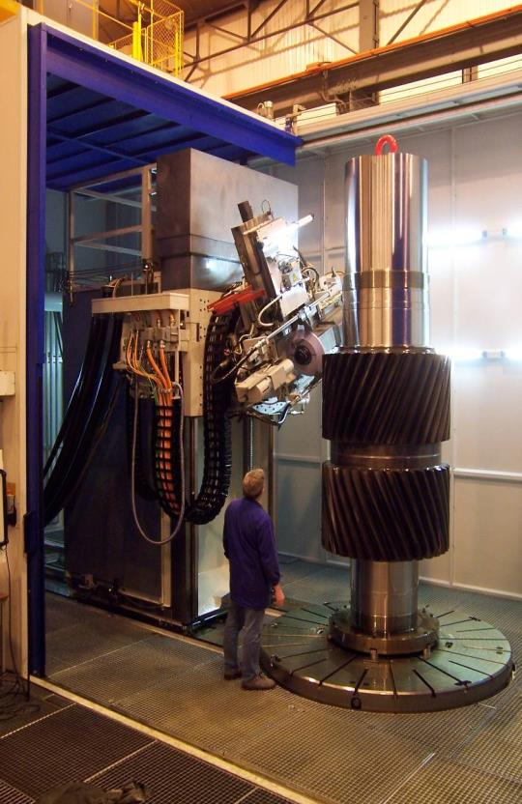
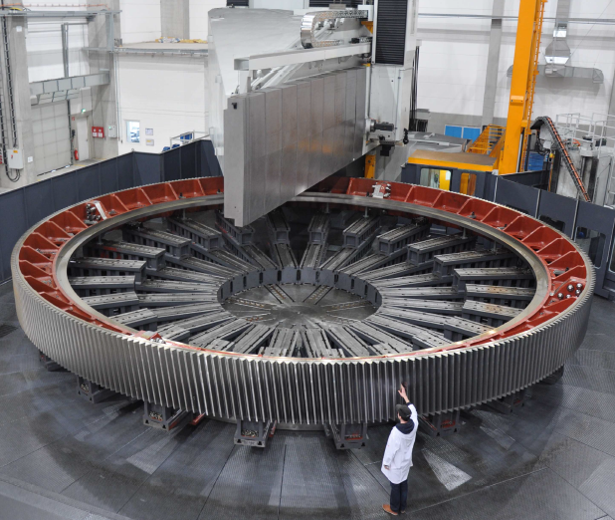






1 – Introduction
Founded in 1901

Slide 4
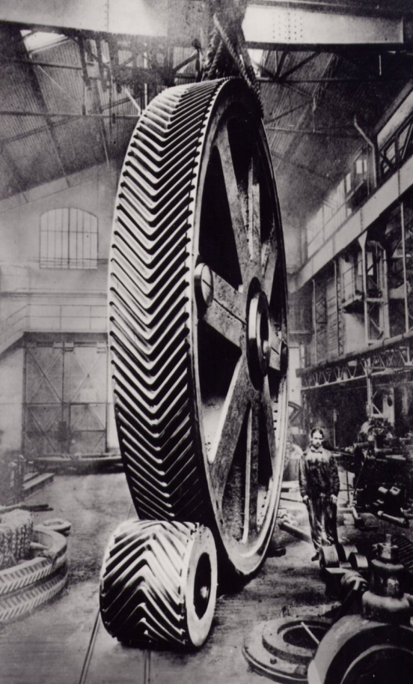
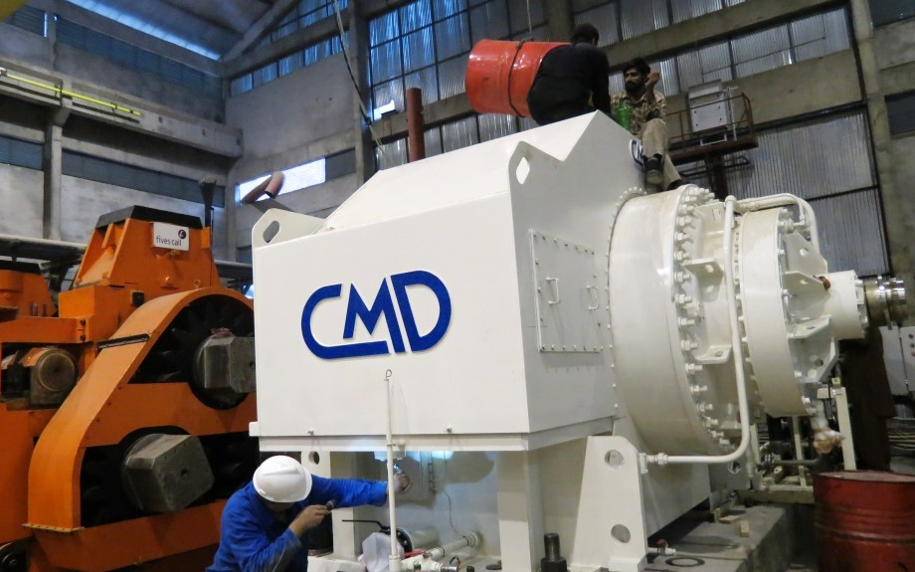
1 – Introduction
1926
Today

Slide 5
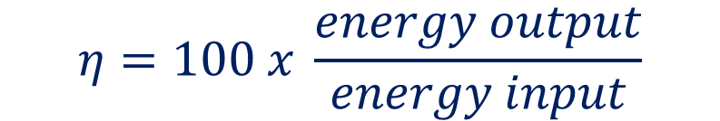
2 – Efficiency – definition & scope of study
Efficiency definition
$$η=100 x \frac{energy output}{energy input}$$

Slide 6
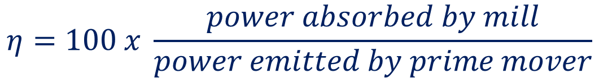
2 – Efficiency – definition & scope of study
In our case – scope of study
Prime mover =
Turbine
electrical motor
Drive System
Mill
$$η=100 x \frac{power absorbed by mill}{power emitted by prime mover}$$

Slide 7
3 – Example of calculation
Energy loss to be considered :
Gear meshing
Bearings
Seals
Oil churning

Slide 8
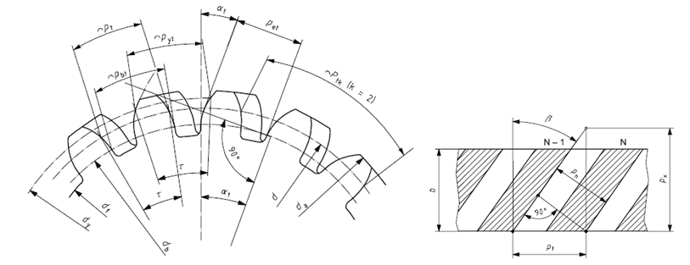
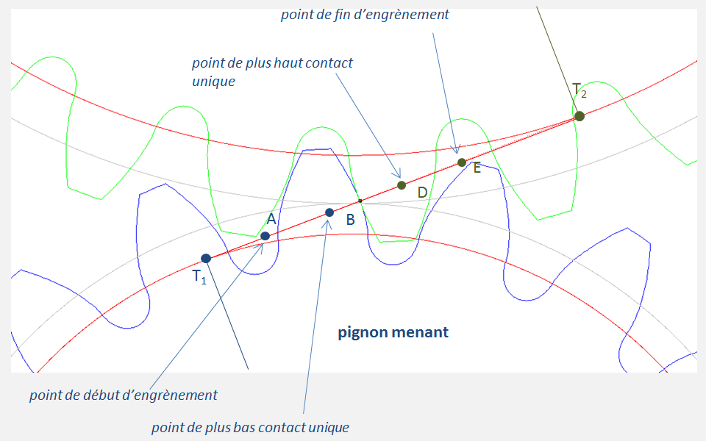
3 – Example of calculation
Gear meshing power loss is going to depend on multiple factors :
- Overall design (nb teeth, module, pressure & helix angle)
Teeth geometrical corrections
(minimize sliding)
Accuracy of machining
Gear materials
Surface roughness
Quality of lubrication
Wear

Slide 9
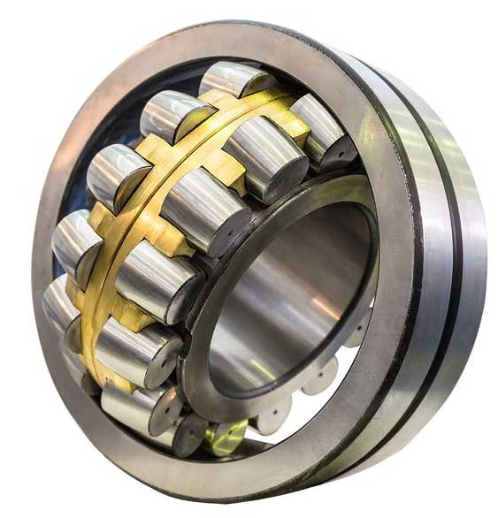
3 – Example of calculation
Bearings power loss is going to depend on multiple factors :
- Overall design (nb bearings, material, cage…)
Clearance & accuracy
Consistency in one set of bearings
Lubrication

Slide 10
3 – Example of calculation
Sealing power loss :
On the CANEflex It is non-contact sealing
Loss of energy is negligible

Slide 11
3 – Example of calculation
Oil churning power loss depends on :
Oil level
Oil type
Volume of components going into the oil
(number of satellites)
- Planet carrier speed

Slide 12
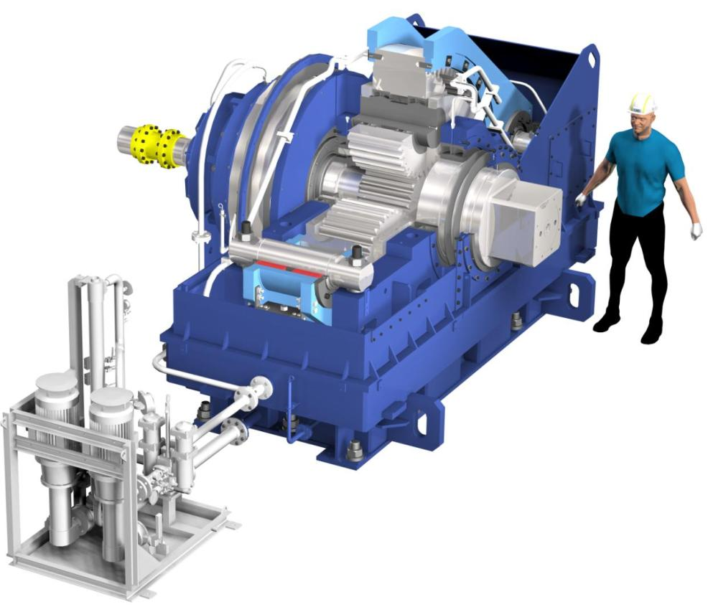
3 – Example of calculation
Example with modern planetary gearbox
Estimated mill size 45’’x90”
CANEflex 3PLH200R Neo
3 planets per stage
Reduction ratio i = 200/1
Absorbed power 1500 HP @ 6 rpm
(1120 kW)
Calculations at nominal speed & power

Slide 13
3 – Example of calculation
Example with modern planetary gearbox
Calculations done with Kiss soft software
Correlated with ISO standards and CMD experience
Total energy loss = 3,0%
Efficiency = 97,0%

Slide 14
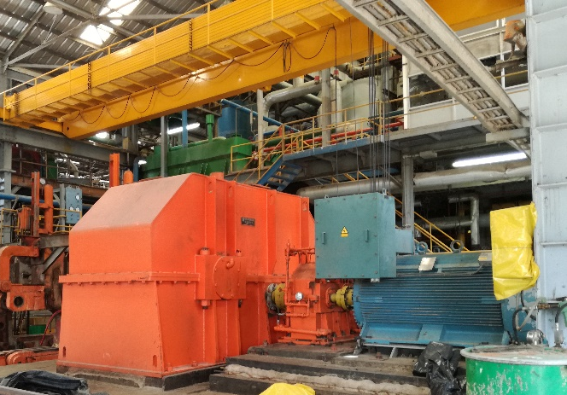
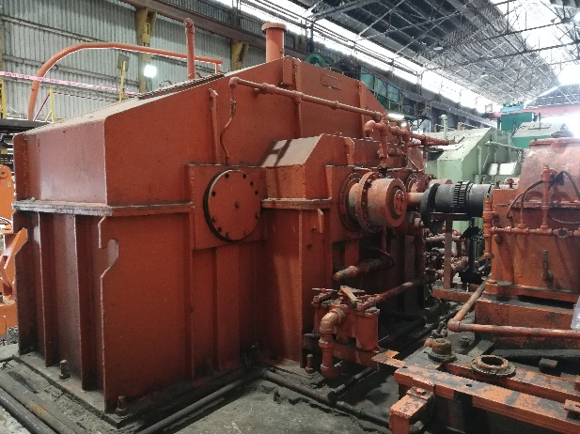
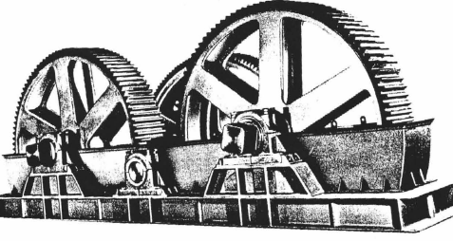
4 – Evolution of the mill drives & their efficiency
Mill drives can be classified into 4 generations :
1st Gen :
Turbine
2 sets Open gears (cast iron or steel)
Double helical or spur
Tail bar
2nd Gen :
Turbine or electrical motor
2 or 3 enclosed gearboxes (carburized)
Double or single helical gears
Tail bar
3rd Gen :
Turbine or electrical motor
Compact gearbox (mixed or carburized)
Helical gears
Tail bar or sling coupling

Slide 15
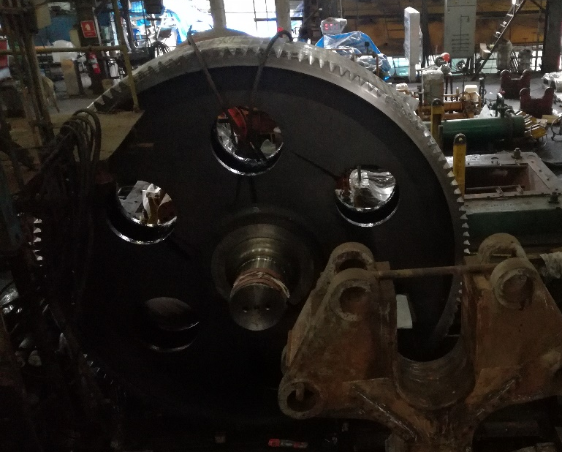
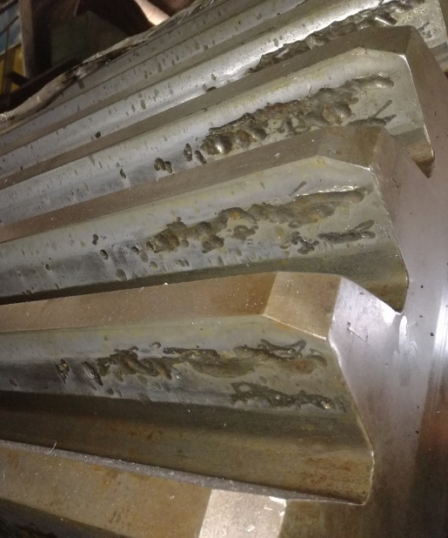
4 – Evolution of the mill drives & their efficiency
1st generation efficiency
Open gears efficiency will depend on :
Type of gears : spur / double helical / helical
Gears design :
Material and hardness : cast iron / cast steel / fabricated steel, from 150 to 350 BHN
Type and lubrication of bearings : slide shoe / roller, grease / oil
Wear will affect the efficiency greatly (modification of profile / increase of sliding / deterioration of surface roughness)

Slide 16
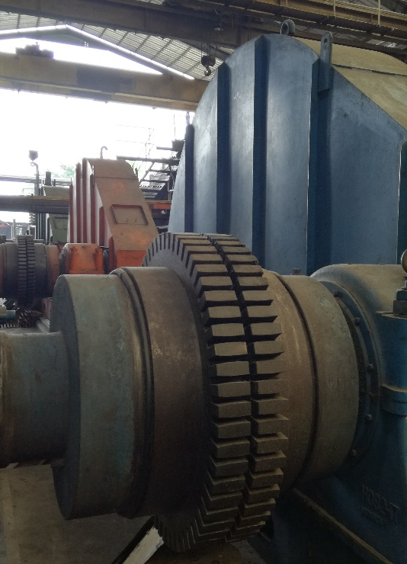
4 – Evolution of the mill drives & their efficiency
1st generation efficiency
Couplings efficiency will depend on :
Type of coupling : grid / gear / rubber
Alignment
Condition
Lubrication

Slide 17
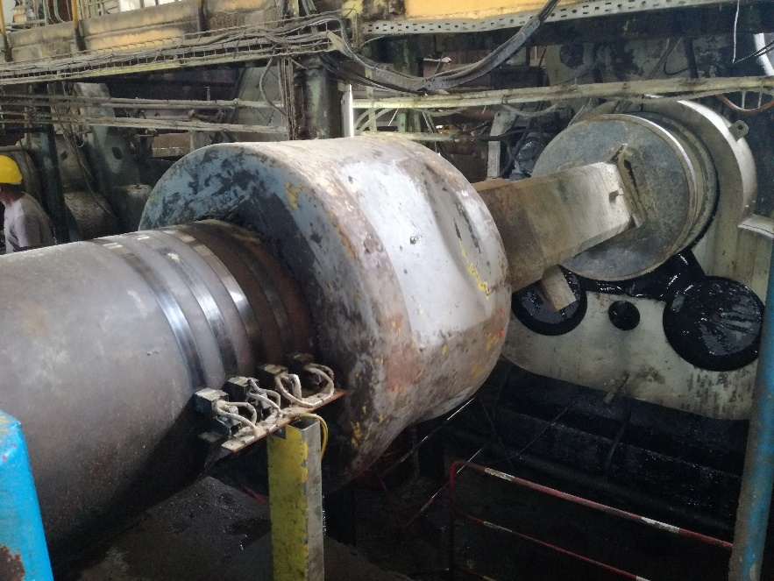
4 – Evolution of the mill drives & their efficiency
1st generation efficiency
Tail bar efficiency will depend on :
Alignment in working condition
Lubrication

Slide 18
4 – Evolution of the mill drives & their efficiency
1st generation efficiency – calculation summary
Efficiency | 1st coupling | 1st stage gears | 2nd coupling | 2nd stage gears | 3rd coupling | 3rd stage gears | Tail bar | Crown pinions | Overall
Best | 99 % | 97 % | 99 % | 97 % | 99 % | 97 % | 95 % | 98 % | 82 %
Worst | 97 % | 90 % | 97 % | 90 % | 97 % | 85 % | 92 % | 92 % | 53 %
Fair | 99 % | 95 % | 99 % | 92 % | 99 % | 90 % | 95 % | 95 % | 69 %

Slide 19

4 – Evolution of the mill drives & their efficiency
2nd generation efficiency – calculation summary
Efficiency | 1st coupling | 1st gearbox | 2nd coupling | 2nd gearbox | Tail bar | Crown pinions | Overall
Best | 99 % | 97 % | 99 % | 95 % | 95 % | 98 % | 84 %
Worst | 97 % | 92 % | 97 % | 88 % | 92 % | 92 % | 65 %
Fair | 99 % | 95 % | 99 % | 90 % | 95 % | 95 % | 76 %

Slide 20

4 – Evolution of the mill drives & their efficiency
3rd generation efficiency – calculation summary
Efficiency | coupling | gearbox | Tail bar / sling | Crown pinions | Overall
Best | 99 % | 94 % | 98 % | 98 % | 89 %
Worst | 97 % | 86 % | 92 % | 92 % | 71 %
Fair | 99 % | 88 % | 95 % | 95 % | 79 %

Slide 21
4 – Evolution of the mill drives & their efficiency
4th generation efficiency – calculation summary
Efficiency | coupling | gearbox | sling | Crown pinions | Overall
Best | 99 % | 97 % | 98 % | 98 % | 92%
Worst | 97 % | 95 % | 96 % | 92 % | 81 %
Fair | 99 % | 97 % | 97 % | 95 % | 89 %

Slide 22
4 – Evolution of the mill drives & their efficiency
Example of financial gain in case of drive system change
Hypothesis :
Tandem of 5 mills 45”x 90” (4 rolls)
Crushing capacity 12 000 TCD
Absorbed power = 1140 kW
Campaign = 160 days, 23 hours/day
Price of electricity = 0,15 USD / kWh

Slide 23
4 – Evolution of the mill drives & their efficiency
Example of financial gain in case of change of drive system to 4th gen – per mill
Generation | Power absorbed by the mill (kW) | Efficiency | Power at motor / turbine (kW) | Energy consumed over one campaign (kWh) | Energy gain with 4th generation (kWh) | Equivalent cost per mill (USD) | Equivalent cost per tandem (USD)
4th | 1140 | 89% | 1280 | 4 713 700 | 0 | 0 | 0
3rd | 1140 | 79% | 1443 | 5 310 380 | 596 680 | 89 502 | 447 510
2nd | 1140 | 76% | 1500 | 5 520 000 | 806 300 | 120 945 | 604 725
1st | 1140 | 69% | 1652 | 6 079 360 | 1 365 660 | 204 849 | 1 024 245
Other gains to be considered :
Reduced maintenance
Reduced cost of spare parts

Slide 24
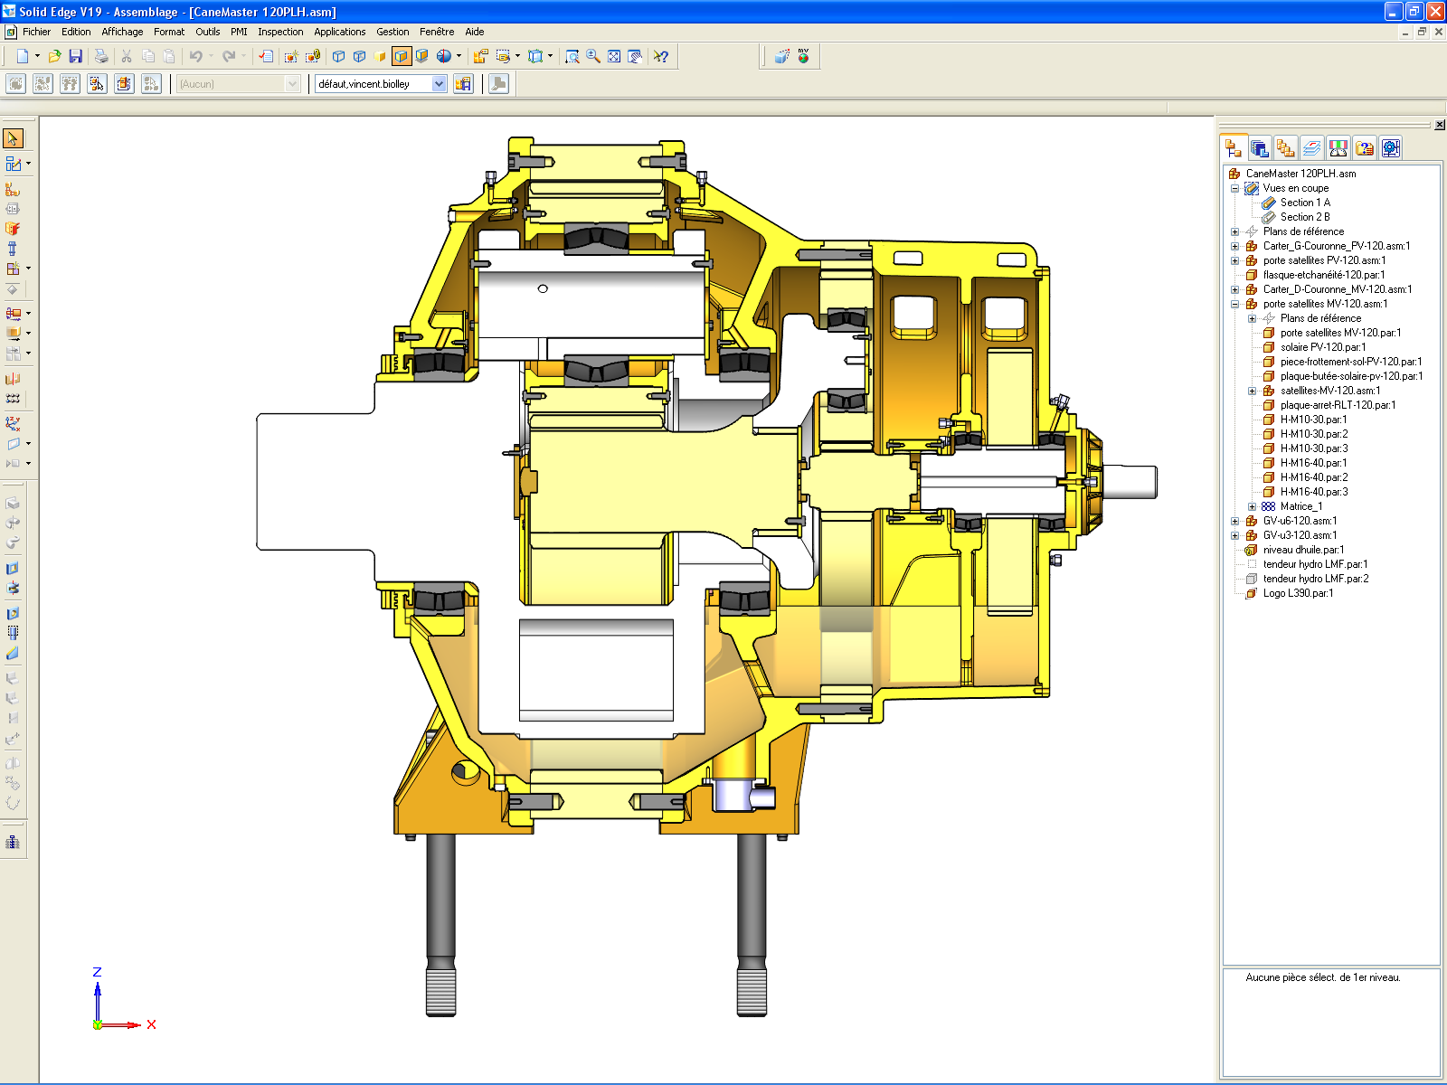
5 – Recommendations
Design and selection:
Prefer lower motor rotation speeds (6 poles / 4 poles)
Limit number of components inside gearbox
Favour 4th gen gearboxes
→ Total 12 bearings (usually 24)
5 bearings references (usually 6))
“big” bearings

Slide 25

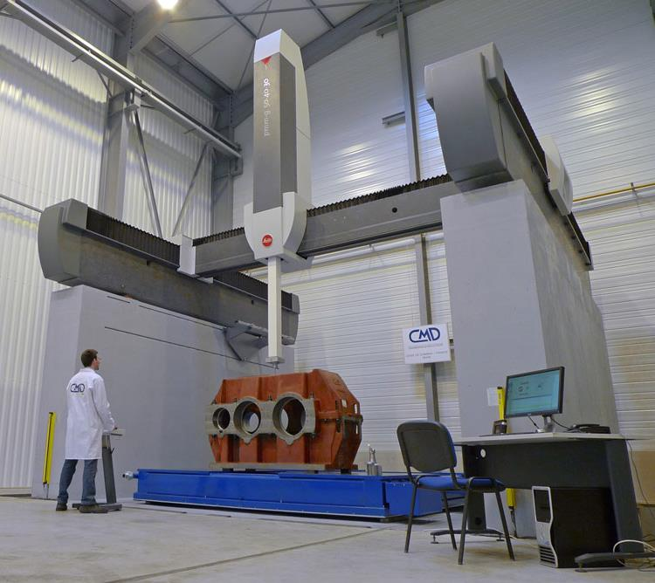
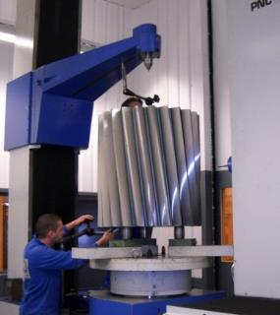
5 – Recommendations
Manufacturing :
Accuracy of manufacturing is essential to improve the efficiency :
  Gears accuracy
  Planet carrier accuracy
Use of correctly selected and paired bearings

Slide 26
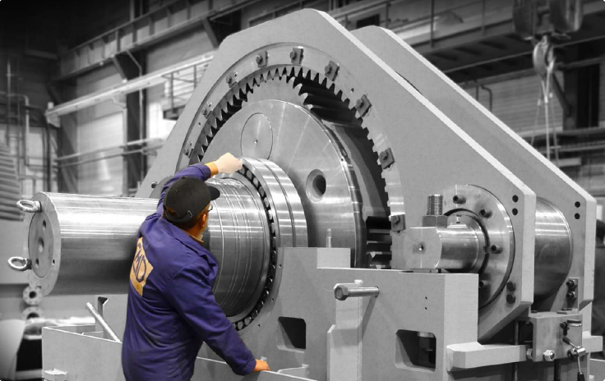

5 – Recommendations
Maintenance practices:
Use the right oil
Analyze the oil every 6 months
Check alignments
Have gearbox setting done by OEM

Slide 27
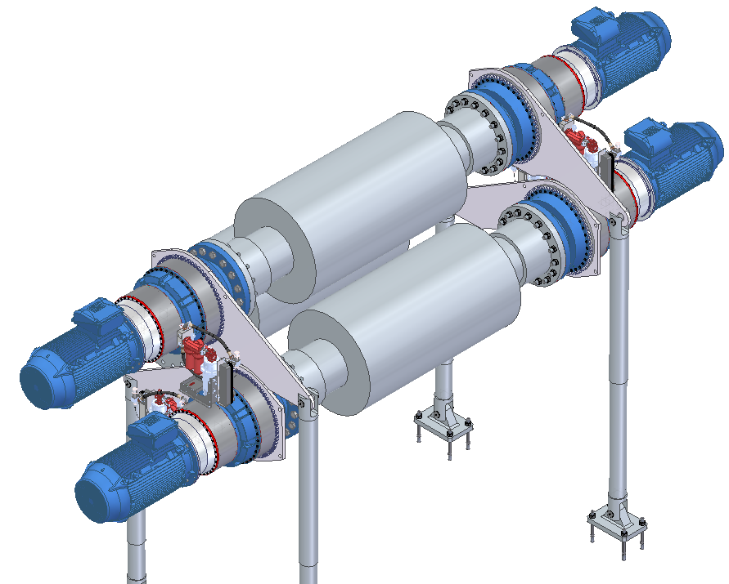
6 – What about Individual Drives ?
Advantages :
No more sling coupling and crown pinions
Mechanical efficiency improved (up to 95%)
Stress on roller shaft reduced
But :
Statistically more failures
Requires 4 gearboxes and 4 electrical drives per mill
Requires space at both sides of mill
A good selection is critical !

Slide 28
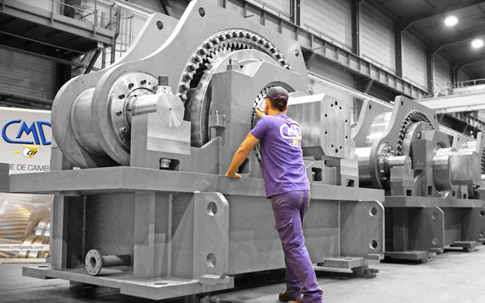
Thank you

Slide 29

www.cmdgears.com
KEEP UP WITH OUR LATEST NEWS !

